Slide 1
Introducing View Object
(Section 5)

Slide 2
Introducing View Object
An ADF view object is a business component that reads data from the datasource, shapes the data to be used by clients, and controls the updates on the data.
In a typical database-centric ADF application, a view object implements the logic for reading database tables through SQL query, and contains the logic for building the collection of rows that can be used by the client. It also controls the data update by delegating the calls to underlying entities.
A view object abstracts the raw JDBC APIs to read data from the database and encapsulates the logic for managing the result set. The ADF view object has a very flexible and layered architecture, which improves the extensibility of the system.

Slide 3
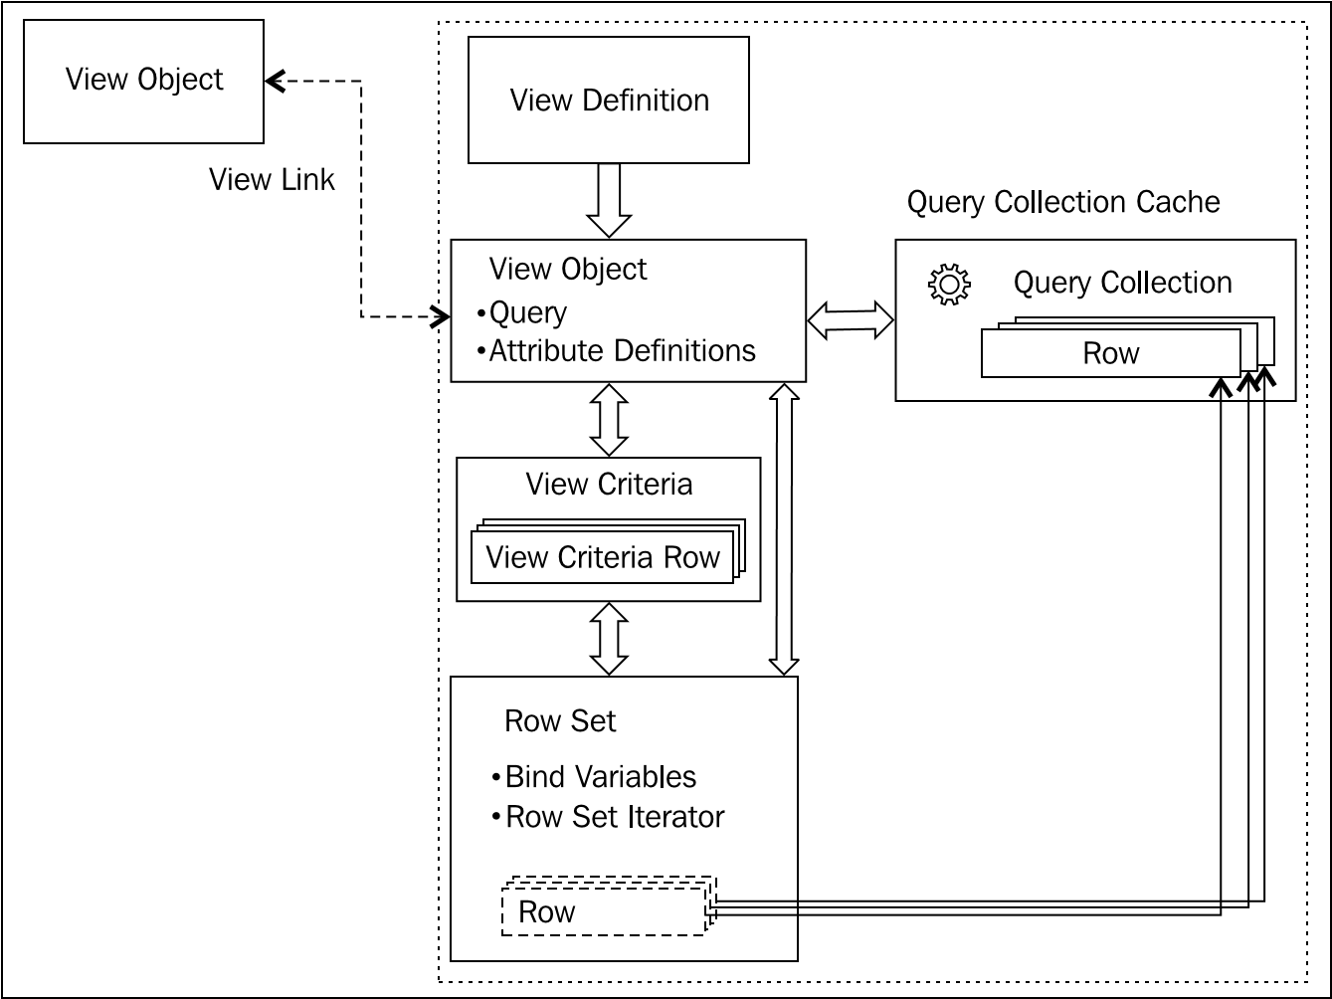
Ingredients of a view object

Slide 4
Ingredients of a view object
View definition XML file
The SQL SELECT statement
Bind parameter definitions
Attribute definition describing each column returned by the query—this includes UI-related metadata, such as UI Hints and UI Categories for attributes
Entity usage information
View accessor definition for accessing other view objects
Business rules

Slide 5
Ingredients of a view object
View definition (oracle.jbo.server.ViewDefImpl)
View object (oracle.jbo. server.ViewObjectImpl)
View criteria
Bind variables
View accessor

Slide 6
Ingredients of a view object
A view object uses the following framework components to set up the infrastructure for query execution and managing the result set:
Row :A row represents an element in the collection
Row set : View object uses row sets to manage the collection of rows from a query.
Row set iterator: This enables the client to traverse the row set and work with individual items.
Query collection: A query collection contains the rows used in a view object.
View link: View link connects two view objects, typically used for implementing master-child relationships.

Slide 7
Core features of ADF view objects
Visual and declarative development
Read-only and updatable view objects
Automated master-child co-ordination
Domain-driven development
Query-by-example support
Caching of result set
Out-of-the-box pagination support
Built-in CRUD operations
Polymorphic view objects
Declarative settings for fine-tuning runtime performance
Customizable framework components
Scalable architecture through out-of-the-box support for activation and passivation cycles

Slide 8

Developing view objects
Creating view objects
Using the Create View Object wizard
It also provides options to build view objects from the following database source types:
Entity object: An entity-based view object is the right choice when the client needs to update the data.
SQL query: A SQL-based view object is a read-only view object, which is built using an explicitly specified SQL query.
Programmatic: If the default implementations of view objects are not enough to meet the requirement for querying some specific datasources such as third-party services or non-database data stores, you can go for a programmatic view object.
Static list: A static list datasource-based view object is useful if the view object needs to act as value holder for a set of non-critical business data, which does not change at runtime.

Slide 9
Creating a view object with entity usage mapping
The first entity object that you select is known as primary entity usage and the rest in the selected list are secondary entity usages.
Select an association for the secondary entity usage from the drop-down list. Based on the association definition, the editor window will populate source entity usage. Now you need to select the suitable join type such as inner join, left outer join, or right outer join.
You can also specify the Updatable, Reference, and Delete Participant properties for entity usages
Updatable: This property decides if the entity object attributes can be modified through view object.
Reference: Select this option if you want the information from this entity object to be treated as read-only reference information in this view object.
Participate in Row Delete: This property decides if the removal of row in a view object will result in deletion of the entity instance participating in the view object row.

Slide 10
Optionally generating Java classes
If you want to customize the default behavior of framework classes or add custom business logic:
View object class: This class is customized to add business methods and to override the default lifecycle of view object instances
View row class: This class represents a row in the result collection in a view object
View object definition class: This class manages the view definition implementation and controls view row creations.
Service data object (SDO) class: This is useful if you want to expose the view object as a web service abstracting the data of the view object.

Slide 11
Annotate attributes using UI hints
View object supports control hints on attributes that describe how the attribute needs to be displayed in the UI. UI hints are typically used for annotating attributes, which can be leveraged in building a model-driven UI.
IDE uses UI hints to infer the component type for each attribute during design time.
ADF framework automatically makes use of the UI hints added to an attribute while rendering it using dynamic model-driven UI components such as query, dynamic form, dynamic table, and model LOV.
Let us take a quick look at the commonly used UI hints for an attribute:
Display Hint
Label
Tooltip
Format Type and Format: Format Type
Control Type
Display Width
Display Height
Category and Field Order
Auto Submit

Slide 12
Adding business rules
You may rarely define updatable transient attributes on a view object. If you find a need to define updatable transient attributes on a view object, check the feasibility of defining it on the underlying entity object, and then use it from the view object as appropriate. This may help you to post the modified value to the appropriate datasource at the right time during the transaction commit cycle. Remember that it is the entity object that participates in the transaction post cycle, not the view object.

Slide 13
Other Components
List of values
To define the LOV, decide the list datasource first. As the ADF Business Components uses the view object to query the datasource.
Linking two view objects
You can link one view object to another view object to form a master details hierarchy of any complexity.
On the View Object page, select the cardinality for the relationship, and then add the source and destination view object attributes, which form the relation. If the source and destination view objects are based on entity objects and there exists an association between the entity objects, you can define view links by choosing the existing associations.
Where clause and Reverse Where clause

Slide 14
Using bind variables
Bind variables are variables that are used in place of dynamic input values in a SQL statement. This has the effect of sending exactly the same SQL statement to the database every time the query is executed.
Programmatically specifying the value for bind variables
Using setNamedWhereClauseParam() on the view object
Using setVariableValue() on VariableValueManager
Using setWhereClauseParam() on the view object

Slide 15
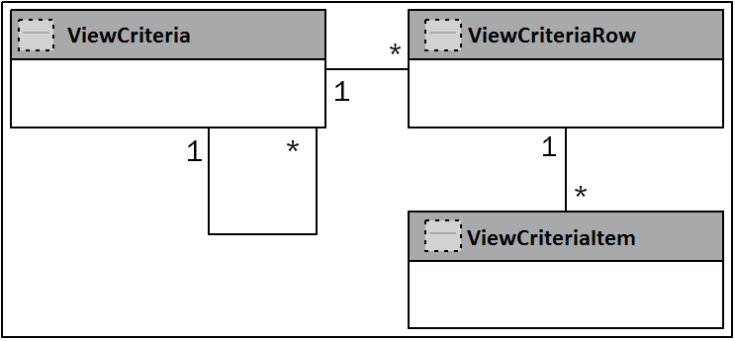
View criteria
The view criteria definition contains the filter information for the rows of a view object. It comprises view criteria rows and view criteria items, which will be used to form the WHERE clause at runtime. This is useful if you want to optionally filter the rows at runtime against the database, in-memory, or both.
Architecture of view criteria
A view criteria can include multiple view criteria or view criteria rows linked by various criteria conjunction types such as AND, OR, and UNION. Each view criteria row can optionally include multiple view criteria items.

Slide 16
View criteria
The query execution mode that you set for the view criteria decides the source to read rows:
Database: In this mode view criteria is used for database query. This is the default mode. You can use the ViewCriteria.CRITERIA_MODE_QUERY constant to refer this mode programmatically.
In-memory: In this mode, view criteria is used for in-memory filtering. You can use the ViewCriteria.CRITERIA_MODE_CACHE constant to refer this mode programmatically.
Both (database and in-memory): In this mode, view criteria is used for a database query first and then for in-memory row filtering:
ViewCriteria.CRITERIA_MODE_QUERY | ViewCriteria.CRITERIA_MODE_CACHE

Slide 17
Using alternate keys in a view object
Alternate keys allow us to define unique keys that can be used for the fast look up of specific entity rows. If you want to enable search based on alternate key for a view object, you will have to define alternate keys at the view object level too.
//In application module implementation class public void findByAlKey(){
ViewObject vo =findViewObject("EmployeeDeptDetails");
//EmployeeDeptDetailVO has two entity objects EmpEO and
//DeptEO. The alt key EmpDeptAltKey is defined on
//EmployeeDeptDetailVO by selecting alt keys from both the
// EO
Key empDeptAltKey = new Key(new Object[] { "JWHALEN",
"Administration" }); //findByAltKey() has the following method signature :
//findByAltKey(String keyName, Key key, int maxNumOfRows,
//boolean skipWhere)
RowIterator iter = vo.findByAltKey("EmpDeptAltKey", empDeptAltKey, -1, false);
}

Slide 18
Using findByKey() on view objects
View objects based on multiple entity usages have the ability to find view rows by using keys from the entity usages.
public Row[] findEmpByKey(Integer empId, Integer deptId) {
// EmployeeDeptDetails has EmployeeEO and DepartmentEO
// as entity usages
ViewObject vo = findViewObject("EmployeeDeptDetails");
//EmployeeId is PK in EmployeeEO and DepartmentId
//is PK in EmployeeEO
//Both these attributes are makrked as Keys in the
//EmployeeDeptDetailsVO
Key key = new Key(new Object[] { empId, deptId });
//-1 implies return all matching rows
Row row[] = vo.findByKey(key, -1); return row;
}

Slide 19
Creating new rows through the view object
Create a new view row by calling createRow() on the view object as shown in the following code snippet:
public void createCountry() {
//Get the view object
ViewObject countries = findViewObject("CountryVO");
// Create a row and fill in the columns.
Row row = countries.createRow();
row.setAttribute("CountryId", "IN");
row.setAttribute("RegionId", 3);
//Insert row in to the default row set
countries.insertRow(row);
}
You can also use createAndInitRow(AttributeList initVals) on the view object to create a new view row.

